Slide 1
OPERATING SYSTEMS
Lecture1
Introduction
Tanenbaum, Modern Operating Systems 3 e, (c) 2008 Prentice-Hall, Inc. All rights reserved. 0-13-6006639

Slide 2
What Is An Operating System?
A modern computer consists of:
One or more processors
Main memory
Disks
Printers
Various input/output devices
Managing all these components requires a layer of software – the operating system
Tanenbaum, Modern Operating Systems 3 e, (c) 2008 Prentice-Hall, Inc. All rights reserved. 0-13-6006639

Slide 3
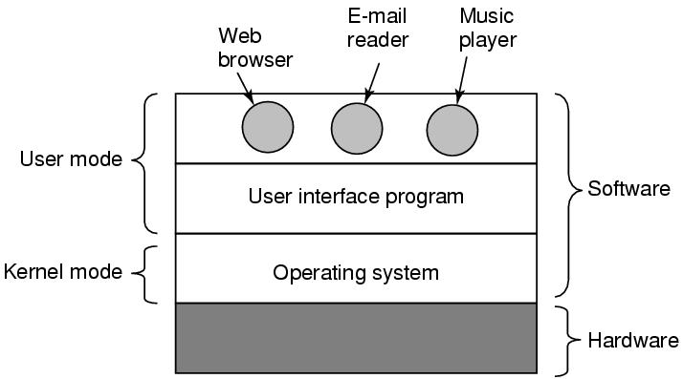
Where is an Operating System?
Where the operating system fits in.
Tanenbaum, Modern Operating Systems 3 e, (c) 2008 Prentice-Hall, Inc. All rights reserved. 0-13-6006639

Slide 4
What Is An Operating System?
A modern computer is very complex
Networking
Disks
Video/audio card
….
It is impossible for every application programmer to understand every detail.
A layer of computer software is introduced to provide a better, simpler, cleaner model of the resources and manage them
Tanenbaum, Modern Operating Systems 3 e, (c) 2008 Prentice-Hall, Inc. All rights reserved. 0-13-6006639

Slide 5
What Is An Operating System?
Users use various OS
Windows, Linux, Mac OS etc.
Users interact with the shell or GUI
Is it part of the OS (The program that users interact with, usually called the shell and the GUI (Graphical User Interface), is actually not part of the operating system, although it uses the operating system to get its work done.)
OS is used to get the work done
Is the device driver part of the OS? What is it?
A piece of software, that deals with the hardware and provides an interface to read and write disk blocks, without getting into the details. Operating systems contain many drivers for controlling I/O devices.
Tanenbaum, Modern Operating Systems 3 e, (c) 2008 Prentice-Hall, Inc. All rights reserved. 0-13-6006639

Slide 6
What Is An Operating System?
On top of the hardware comes the OS
Most computers have two modes of operation:
Kernel mode
User mode
OS runs in the kernel mode which has complete access to all hardware and can execute any instruction.
The rest of the software runs in the user mode, which has limited capability
Shell or GUI is the lowest level of user mode software
Tanenbaum, Modern Operating Systems 3 e, (c) 2008 Prentice-Hall, Inc. All rights reserved. 0-13-6006639

Slide 7
What Is An Operating System?
Operating systems have two functions:
1- From top to down: provides application programmers a clean abstract set of resources instead of hardware ones. (Extended Machine)
2- From down to top: Manage these hardware resources (Resource Manager)
Four types of people:
Industrial engineer: design hardware
Kernel designer
Application programmer: OS’s user
End users
Tanenbaum, Modern Operating Systems 3 e, (c) 2008 Prentice-Hall, Inc. All rights reserved. 0-13-6006639

Slide 8
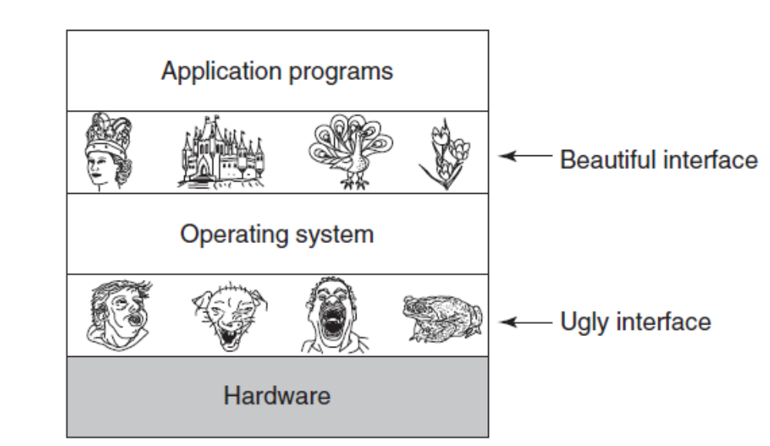
The Operating System as an Extended Machine
Operating systems turn ugly hardware into beautiful abstractions
Tanenbaum, Modern Operating Systems 3 e, (c) 2008 Prentice-Hall, Inc. All rights reserved. 0-13-6006639

Slide 9
The Operating System as an Extended Machine
Abstraction:
CPU -- process
Storage -- files
Memory -- address space
Tanenbaum, Modern Operating Systems 3 e, (c) 2008 Prentice-Hall, Inc. All rights reserved. 0-13-6006639

Slide 10
The Operating System as a Resource Manager
Modern OS run multiple programs of multiple users at the same time
  Imagine what would happen if several programs want to print at the same time
  How to account the resource usage of each process
  If resources are multiplexed, how to ensure fairness and efficiency
Tanenbaum, Modern Operating Systems 3 e, (c) 2008 Prentice-Hall, Inc. All rights reserved. 0-13-6006639

Slide 11
The Operating System as a Resource Manager
Allows multiple programs to run at the same time
Manages and protects the memory, I/O devices, and other resources
Multiplexes (shares) resources in two different ways:
  In time: When a resource is time multiplexed, different programs or users take turns using it. For example, with only one CPU and multiple programs the operating system first allocates the CPU to one program, then, after it has run long enough, another program gets to use the CPU.
  In space: Instead of the customers taking turns, each one gets part of the resource. For example, main memory is normally divided up among several running programs, so each one can be resident at the same time
Tanenbaum, Modern Operating Systems 3 e, (c) 2008 Prentice-Hall, Inc. All rights reserved. 0-13-6006639

Slide 12
The Operating System in brief
Is a complex software
Runs in the kernel mode
Manages hardware
Provides a friendly interface for the application programmer
Tanenbaum, Modern Operating Systems 3 e, (c) 2008 Prentice-Hall, Inc. All rights reserved. 0-13-6006639

Slide 13
History of Operating Systems
Generations:
(1945–55) Vacuum Tubes
(1955–65) Transistors and Batch Systems
(1965–1980) ICs and Multiprogramming
(1980–Present) Personal Computers, Tablets, Phones
Tanenbaum, Modern Operating Systems 3 e, (c) 2008 Prentice-Hall, Inc. All rights reserved. 0-13-6006639

Slide 14
History of Operating Systems
1st: Vacuum Tubes
Large and slow
Engineers design, build, operate and maintain the computer
All programming is done with machine language or by wiring circuits using cables
Insert plugboards into the computer and operate
Work is mainly numerical calculations
Tanenbaum, Modern Operating Systems 3 e, (c) 2008 Prentice-Hall, Inc. All rights reserved. 0-13-6006639

Slide 15
History of Operating Systems
2nd : Transistors and batch systems
Also called mainframes
Computers are managed by professional operators
Programmers use punch card to run programs; operators operate (load compiler, etc) and collect output to the user.
Complains soon come:
Human operation between computer operation
Leads to batch systems
Collect a batch of jobs in the input room, then read them into a magnetic tape and the same for output
Tanenbaum, Modern Operating Systems 3 e, (c) 2008 Prentice-Hall, Inc. All rights reserved. 0-13-6006639

Slide 16

Transistors and Batch Systems (1)
An early batch system.
(a) Programmers bring cards to 1401.
(b)1401 reads batch of jobs onto tape.
Tanenbaum, Modern Operating Systems 3 e, (c) 2008 Prentice-Hall, Inc. All rights reserved. 0-13-6006639

Slide 17
Transistors and Batch Systems (2)
(c) Operator carries input tape to 7094.
(d) 7094 does computing. (e) Operator carries output tape to 1401. (f) 1401 prints output.
Tanenbaum, Modern Operating Systems 3 e, (c) 2008 Prentice-Hall, Inc. All rights reserved. 0-13-6006639

Slide 18
History of Operating Systems
3rd : ICs and multiprogramming
OS/360:
However OS/360 introduces several key techniques:
Muti-programming: solves the problem of CPU idling
Spooling: simultaneous peripheral operation online: Whenever a job finishes, OS loads a new job from the disk to the empty partition.
Tanenbaum, Modern Operating Systems 3 e, (c) 2008 Prentice-Hall, Inc. All rights reserved. 0-13-6006639

Slide 19
History of Operating Systems
4th : Personal Computers
With the development of LSI (Large Scale Integration) circuits—chips containing thousands of transistors on a square centimeter of silicon—the age of the personal computer dawned.
Computers have performance similar to 3rd generation, but prices drastically different.
Develops with hardware and user needs
Multi-user, multi-programming, time-sharing
Tanenbaum, Modern Operating Systems 3 e, (c) 2008 Prentice-Hall, Inc. All rights reserved. 0-13-6006639

Slide 20
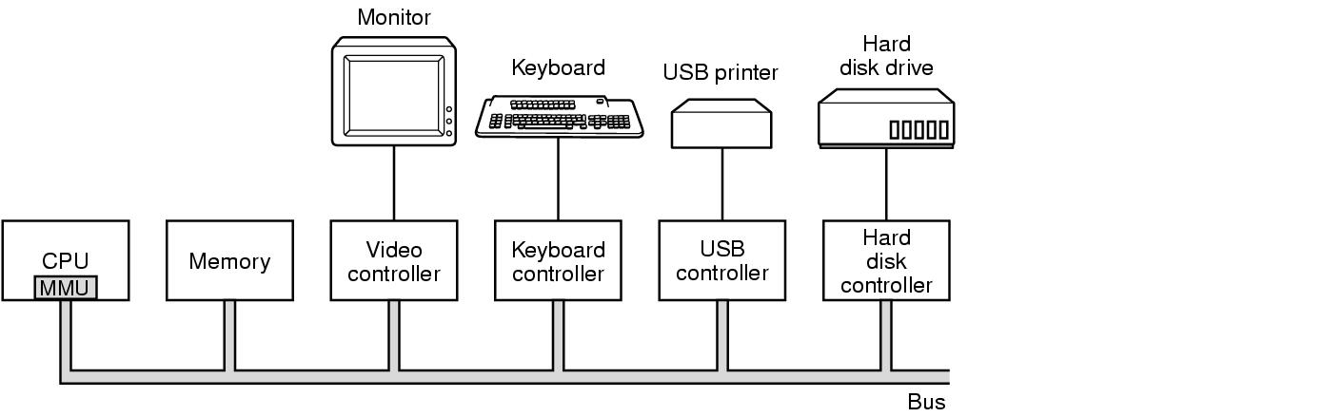
Computer Hardware Review
Some of the components
of a simple personal computer
Tanenbaum, Modern Operating Systems 3 e, (c) 2008 Prentice-Hall, Inc. All rights reserved. 0-13-6006639

Slide 21
CPU
Brain of the computer:
Fetches instructions from the memory and executes
Cycle of CPU:
Fetch – Decode – Execute
CPU has registers to store variables and temporary results: load from memory to register, store from register to memory
Program counter: next instruction to fetch
Stack pointer: the top of the current stack
PSW: Program Status Word (performs the functions of a status register): This register contains the condition code bits, which are set by comparison instructions, the CPU priority, the mode (user or kernel), and various other control bits.
.
Tanenbaum, Modern Operating Systems 3 e, (c) 2008 Prentice-Hall, Inc. All rights reserved. 0-13-6006639
Notes:
MULTICS
Timesharing CTSS (MIT)
Multics
UNix

Slide 22
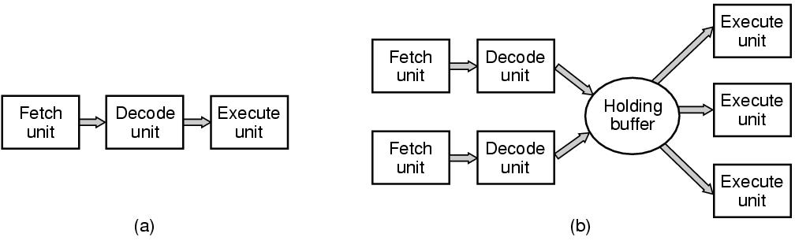
CPU Pipelining
A three-stage pipeline. (b) A superscalar CPU.
Accelerates the execution
For superscalar: instructions are often operated out of order
Tanenbaum, Modern Operating Systems 3 e, (c) 2008 Prentice-Hall, Inc. All rights reserved. 0-13-6006639

Slide 23
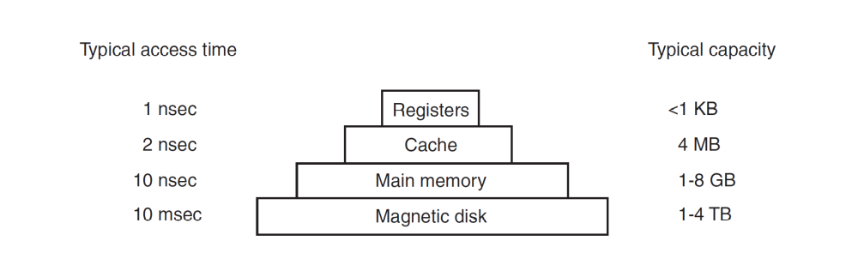
Memory Hierarchy
A typical memory hierarchy.
The numbers are very rough approximations.
Tanenbaum, Modern Operating Systems 3 e, (c) 2008 Prentice-Hall, Inc. All rights reserved. 0-13-6006639

Slide 24
Caches
Main memory is divided into cache lines (64 bytes)
  0-63 in line 1, 64-127 in line 2
The most heavily used cache lines are kept in a high-speed cache located inside or very close to the CPU.
When a program reads a word-cache hardware it checks to see if in cache.
  If so, then we have a cache hit (2 cycles).
  Otherwise we have a cache miss, make request of main memory over the bus (more time)
Cache is expensive and is therefore limited in size
Can have cache hierarchies each one slower and bigger than the one before it.
Ex: the address of a Web page (URL) is converted to a network address (IP address), the result can be cached for future use
Tanenbaum, Modern Operating Systems 3 e, (c) 2008 Prentice-Hall, Inc. All rights reserved. 0-13-6006639

Slide 25
The 4 Cache Questions
When to put a new item into the cache? (on a cache miss)
Which cache line to put the new item in? (memory word determines which line)
Which item to remove from the cache when a slot is needed? (same line new data goes into)
Where to put a newly evicted item in main memory?
Tanenbaum, Modern Operating Systems 3 e, (c) 2008 Prentice-Hall, Inc. All rights reserved. 0-13-6006639

Slide 26
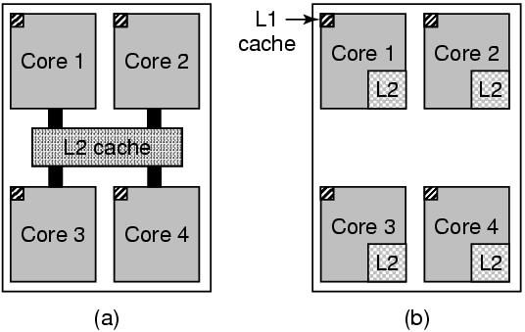
Multithreaded and Multicore Chips
(a) A quad-core chip with a shared L2 cache.
(b) A quad-core chip with separate L2 caches.
Tanenbaum, Modern Operating Systems 3 e, (c) 2008 Prentice-Hall, Inc. All rights reserved. 0-13-6006639

Slide 27
Main Memory
RAM
ROM-can’t be changed. Fast, cheap
  eg.-keeps bootstrap OS loader
EEPROM (Electrically Erasable PROM) Can be re-written, but slowly
  E.g.-serves as films in digital cameras, as disk in portable music players
.
Tanenbaum, Modern Operating Systems 3 e, (c) 2008 Prentice-Hall, Inc. All rights reserved. 0-13-6006639
Notes:
MULTICS
Timesharing CTSS (MIT)
Multics
UNix

Slide 28
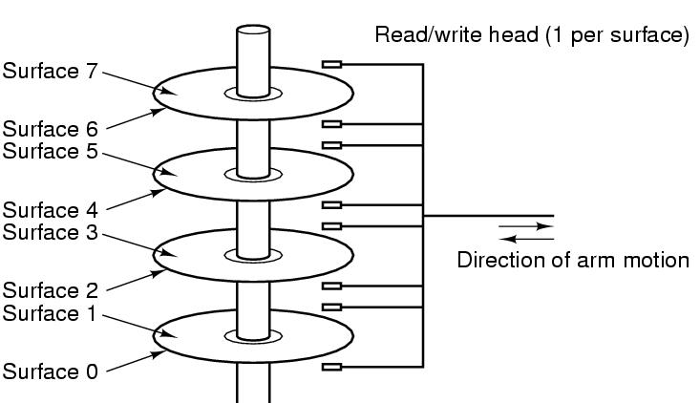
Disks
Tracks are divided into sectors (512 bytes)
Multiple tracks form a cylinder.
Tanenbaum, Modern Operating Systems 3 e, (c) 2008 Prentice-Hall, Inc. All rights reserved. 0-13-6006639

Slide 29
I/O Devices
Controller runs a device - accepts commands from the OS and executes them
Complicated business
  Eg. Gets a command to read sector x on disk y. Must convert to (cylinder, sector, head) address, move arm to correct cylinder, wait for sector to rotate under the head, read and store bits coming off the drive, compute checksum, store bits as words in memory
Controller contains a computer to run its device
Tanenbaum, Modern Operating Systems 3 e, (c) 2008 Prentice-Hall, Inc. All rights reserved. 0-13-6006639

Slide 30
Device Driver
OS software that talks to the controller - gives commands, accepts responses
Each controller manufacturer supplies a driver for each OS
Driver runs in kernel mode
Controller has registers which are used to communicate with the driver
Tanenb aum, Modern Operating Systems 3 e, (c) 2008 Prentice-Hall, Inc. All rights reserved. 0-13-6006639

Slide 31
The Operating System Zoo
Mainframe operating systems
Server operating systems
  Multiprocessor operating systems
PC operating systems-Linux, Mac, Windows
Smart phone operating systems
Embedded operating systems
Real time operating systems
Smart card operating systems
Tanenbaum, Modern Operating Systems 3 e, (c) 2008 Prentice-Hall, Inc. All rights reserved. 0-13-6006639

Slide 32
Operating System Concepts
Processes
Address spaces
Files
Input/Output
Protection
The shell
Tanenbaum, Modern Operating Systems 3 e, (c) 2008 Prentice-Hall, Inc. All rights reserved. 0-13-6006639

Slide 33
Processes
Program in execution
Lives in the address space
Process table
  Keeps info about process
  Used to re-start process
Shell (command interpreter) reads commands from terminal
Tanenbaum, Modern Operating Systems 3 e, (c) 2008 Prentice-Hall, Inc. All rights reserved. 0-13-6006639

Slide 34

A Process Tree
Process creates child processes
Tree structure
Processes Can communicate with one another
Have User ID’s (UID) and Group ID’s (GID)
Tanenbaum, Modern Operating Systems 3 e, (c) 2008 Prentice-Hall, Inc. All rights reserved. 0-13-6006639

Slide 35
Address Space
The memory used by a process
MOS (management operating system) allows multiple processes in memory simultaneously
Tanenbaum, Modern Operating Systems 3 e, (c) 2008 Prentice-Hall, Inc. All rights reserved. 0-13-6006639

Slide 36
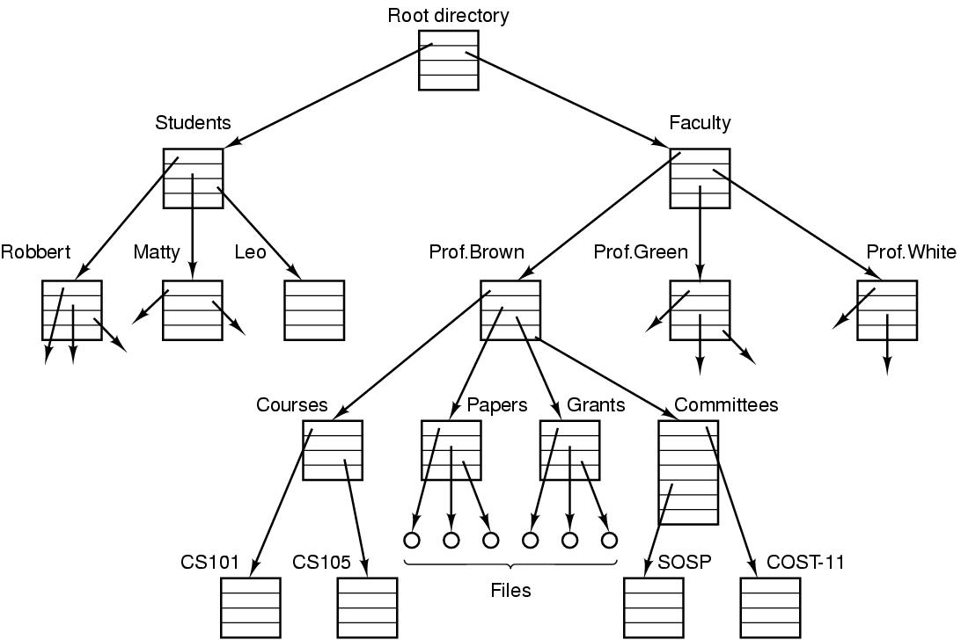
Files
  The directory is organized as a tree
  Root directory at the top. Path proceeds from the root (e.g. faculty/prof brown/courses)
Tanenbaum, Modern Operating Systems 3 e, (c) 2008 Prentice-Hall, Inc. All rights reserved. 0-13-6006639

Slide 37
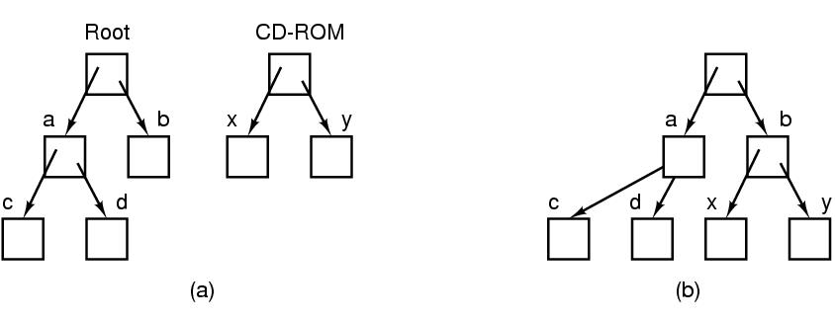
Files
(a) CD-Rom files are not accessible before mounting
(b) A CD-ROM is mounted on directory b to be accessible
Tanenbaum, Modern Operating Systems 3 e, (c) 2008 Prentice-Hall, Inc. All rights reserved. 0-13-6006639

Slide 38
I/O, Protection, Shell
I/O- every operating system has an I/O subsystem for managing its I/O devices. Some of the I/O software is device independent, that is, applies to many or all I/O devices equally well. Other parts of it, such as device drivers, are specific to particular I/O devices.
Protection-UNIX uses rwx bits for each file
  3 bits for owner, 3 for group, 3 for everyone else
Shell (command interpreter)
  UNIX
  Has lots of flavors-sh,bash,csh,ssh…..
  Sort<file1>file2
  Cat file 1 file 2 file3 | sort > /dev/lp
Tanenbaum, Modern Operating Systems 3 e, (c) 2008 Prentice-Hall, Inc. All rights reserved. 0-13-6006639

Slide 39
System Calls
Interface between user programs and OS
Varies from OS to OS
System call issued by user program
Library routine puts the machine into kernel modes (by issuing a special instruction)
Finds the actual routine for system call in a table
Does the work involved in the call
Returns to user program
Tanenbaum, Modern Operating Systems 3 e, (c) 2008 Prentice-Hall, Inc. All rights reserved. 0-13-6006639

